Slide 1
Sensation, Perception & Attention
Randall C. O’Reilly

Slide 2
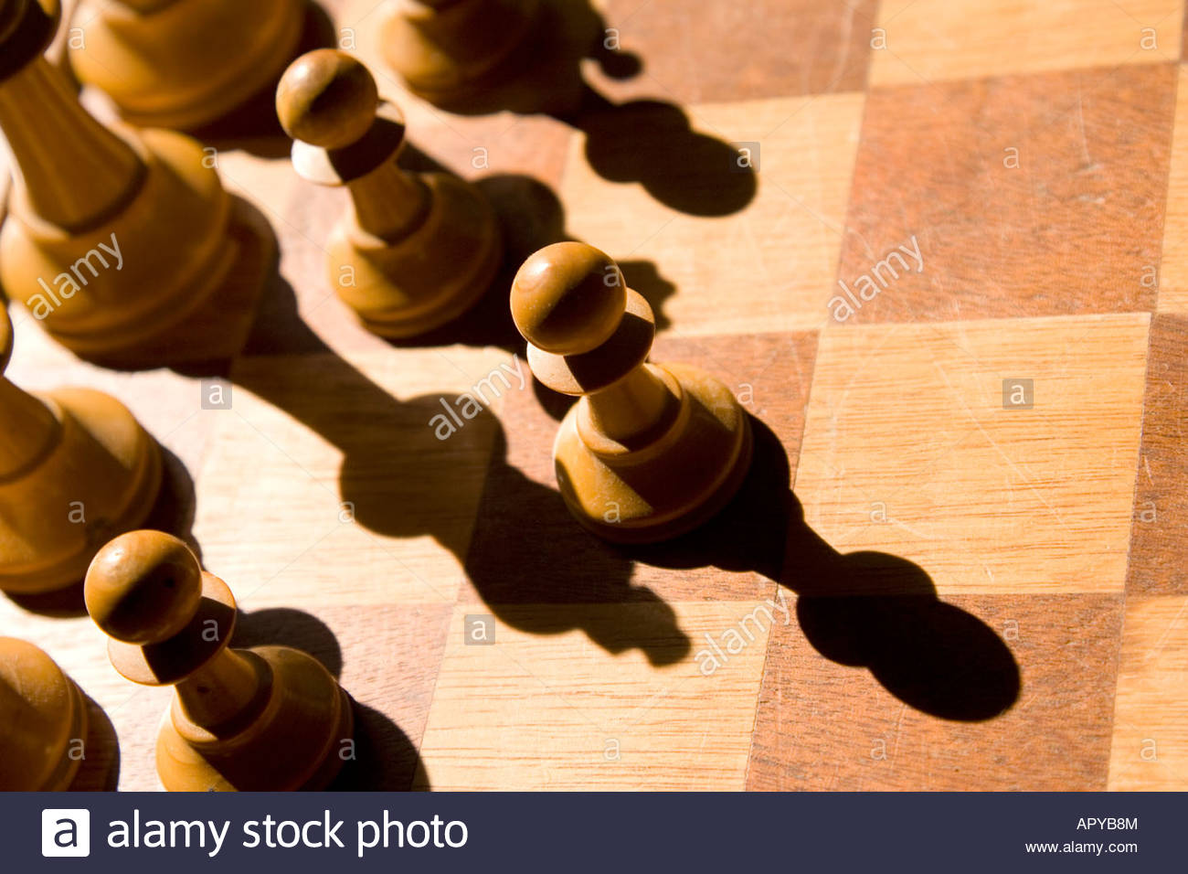
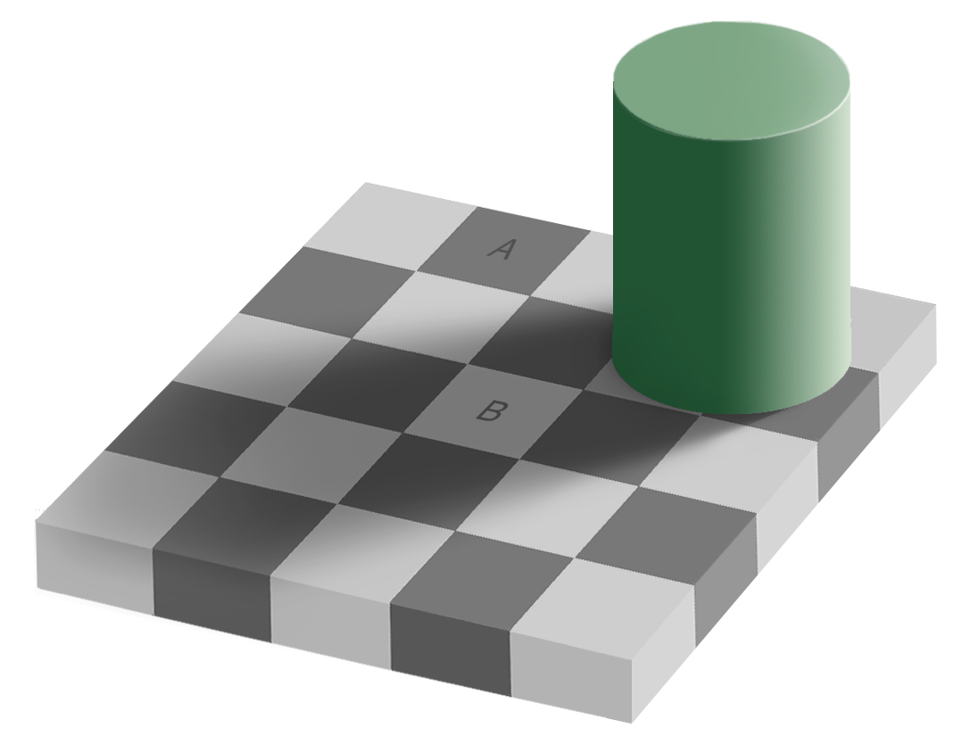
Perception = Compression
Nothing interesting to see here – keep moving on..

Slide 3
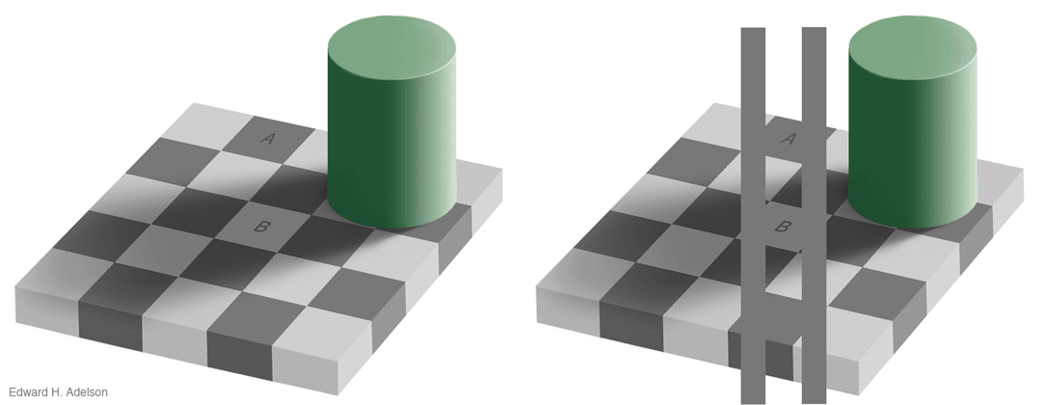
What!?
A = B??
No Way!
Way!

Slide 4
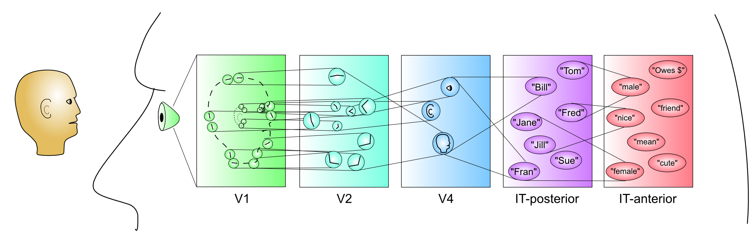
Awareness: Top of Compression
Perception = awareness of high levels of hierarchy of compression – just the simple, “sensible” story
We see the world, not our raw sensory input!

Slide 5
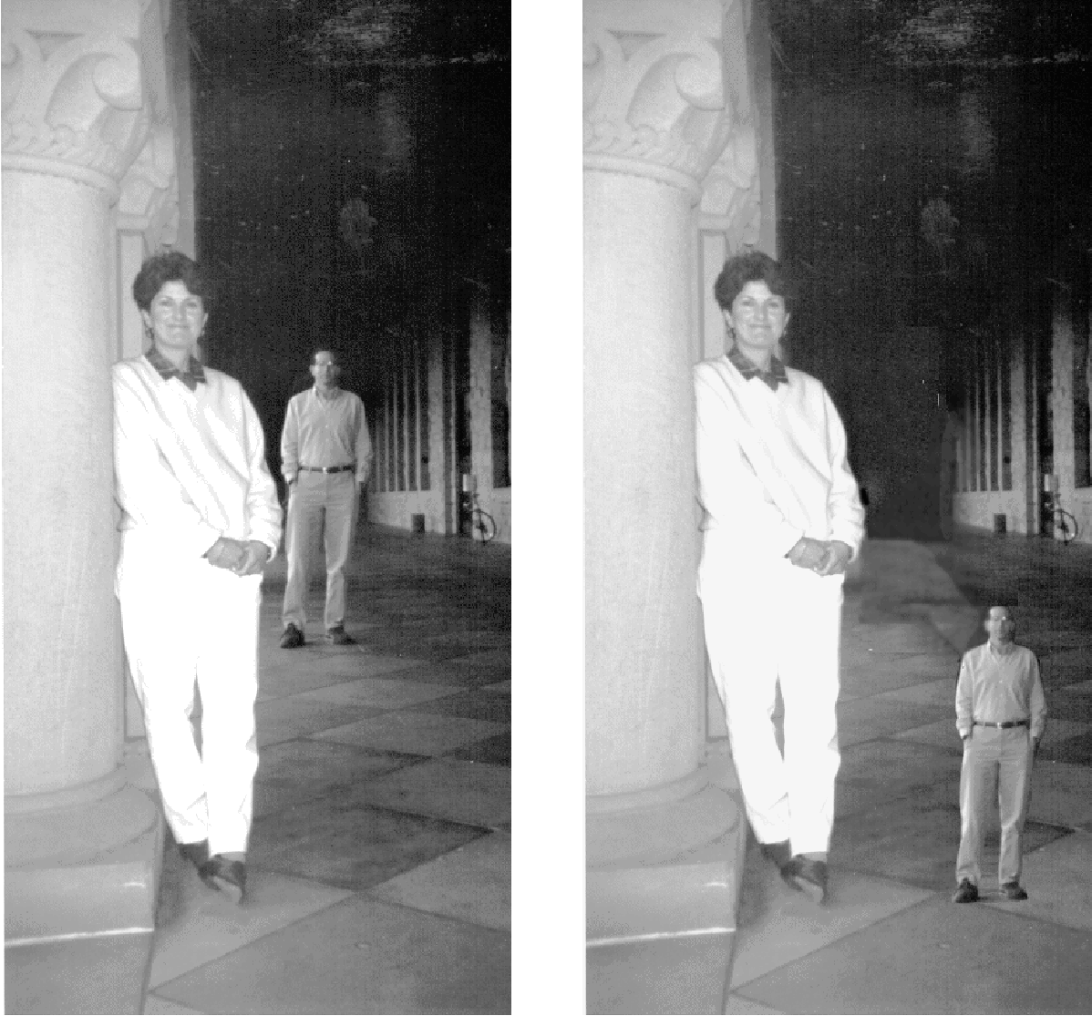
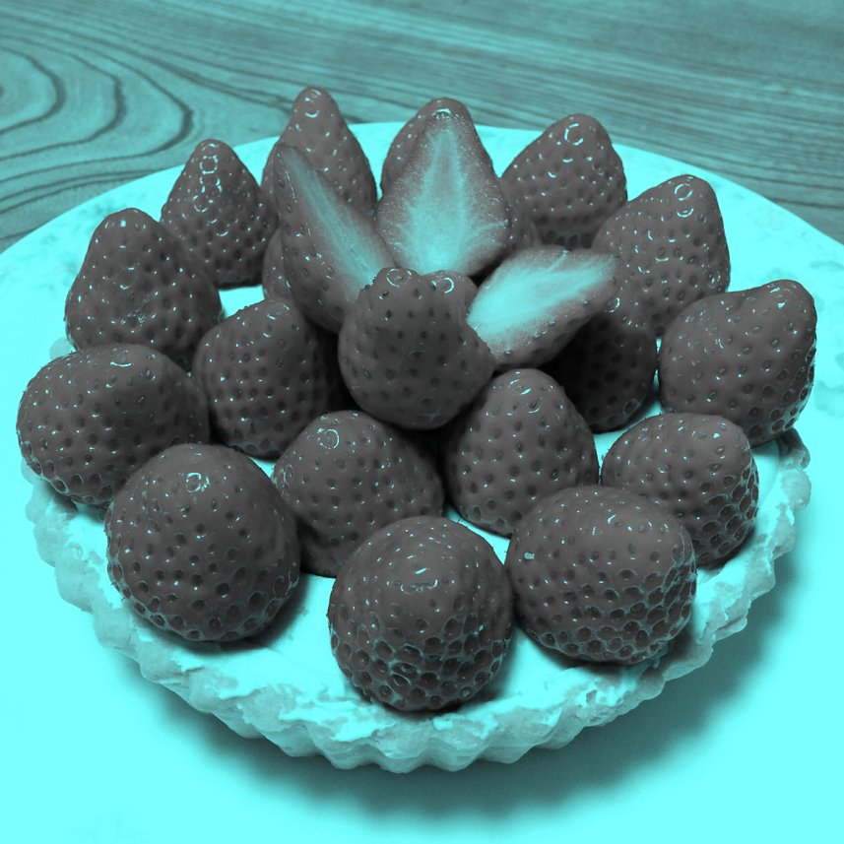
“Constancy”
We see the world, not our raw sensory input: the world is constant despite differences in lighting, positions, etc

Slide 6
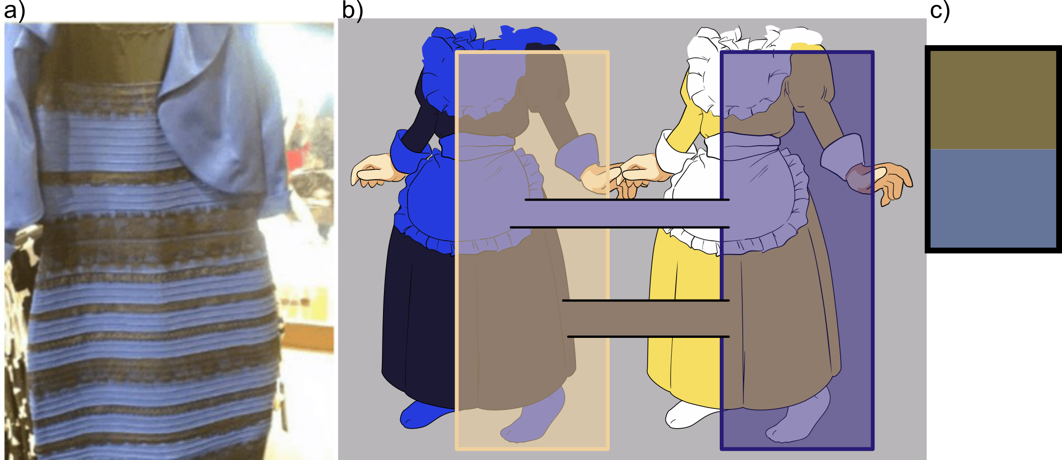
Viral (In)constancy

Slide 7
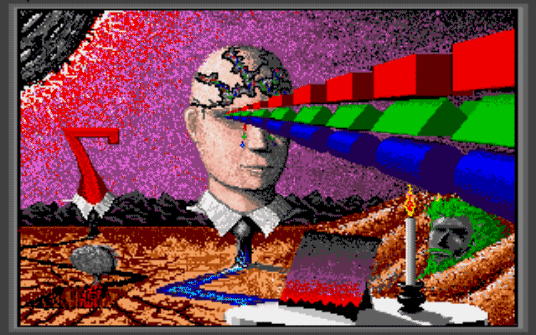
Perception: Open Them Doors!
Perception opens the door to illusion, as well as truth, sadness, and other strange things..

Slide 8
5+2 senses
Modality | Stimulus | Receptors | Thal -> Cortex | Absolute threshold
Vision (sight) | Light (photons) | Rods & Cones in Retina | LGN -> V1 | Candle flame from 30 miles (on clear night)
Audition (hearing) | Sound (variation in air pressure) | Hair cells in Cochlea | MGN -> A1 | Tick of watch at 20 feet (in a quiet room)
Olfaction (smell) | Airborne molecules | Hair cells in Olfactory epithelium | (none) -> Olfactory cortex | 1 drop of perfume diluted in air of 6 room house
Gustation (taste) | Food molecules | Taste Buds in Papillae | VPN -> Insula | 1 teaspoon of sugar in 2 gallons of water (try it!)
Somesthesis (touch) | Touch, pressure, temperature, pain | Free nerve endings in Skin | PMN, VPN -> S1 | Wing of a fly falling on cheek from 1cm
Proprioception (self movement) | Muscle stretch | Muscle Spindle fibers | VPS -> S1
Vestibular (balance) | Head rotation, acceleration | Semicircular Canals & Otoliths | VPN -> S1

Slide 9
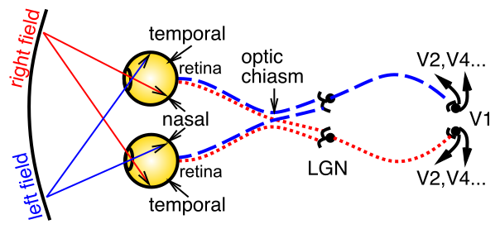
The First Sense: Vision
Light goes through pupil, size of which controlled by iris, lens focuses on retina, containing rod (fast, b/w) and cone (slow, color) photoreceptors. LGN = thalamus, V1 = primary visual cortex.

Slide 10
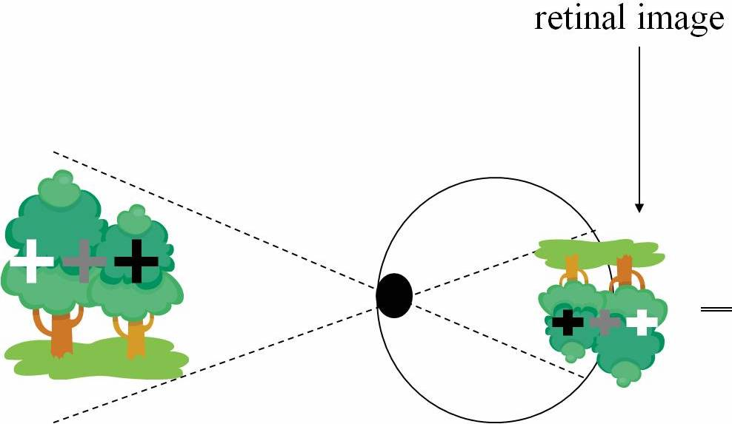
More proof we don’t see retina
Why do mirrors flip horizontally, not vertically!?
https://www.youtube.com/watch?v=vBpxhfBlVLU (Physics Girl)

Slide 11
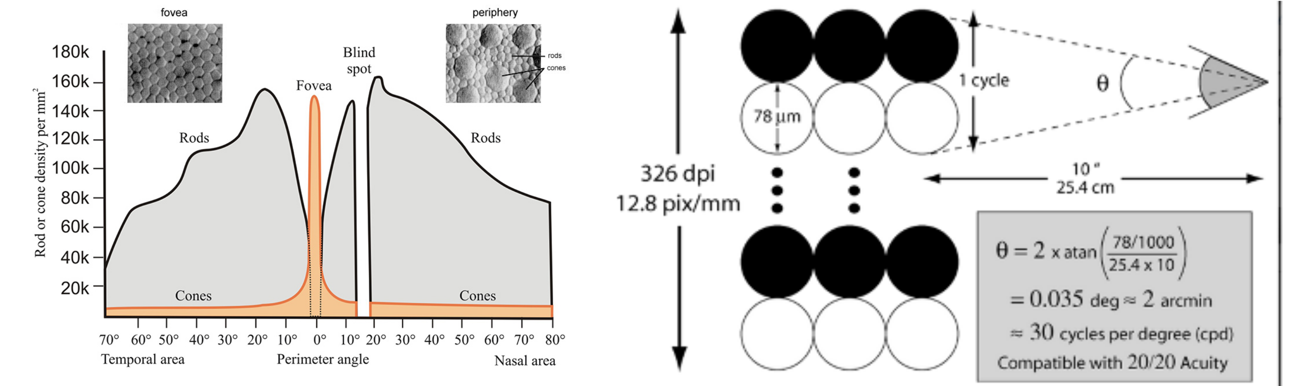
How Many Megapixels??
Retina has ~100 mega-rods, only ~5-7 mega-cones
Fovea can resolve about 30 cycles-per-degree (requires cone spacing of ~.3 arcmin) = ~300 dpi at 10” (close!)
Focal length of human eye is ~22mm, max ISO about 800

Slide 12
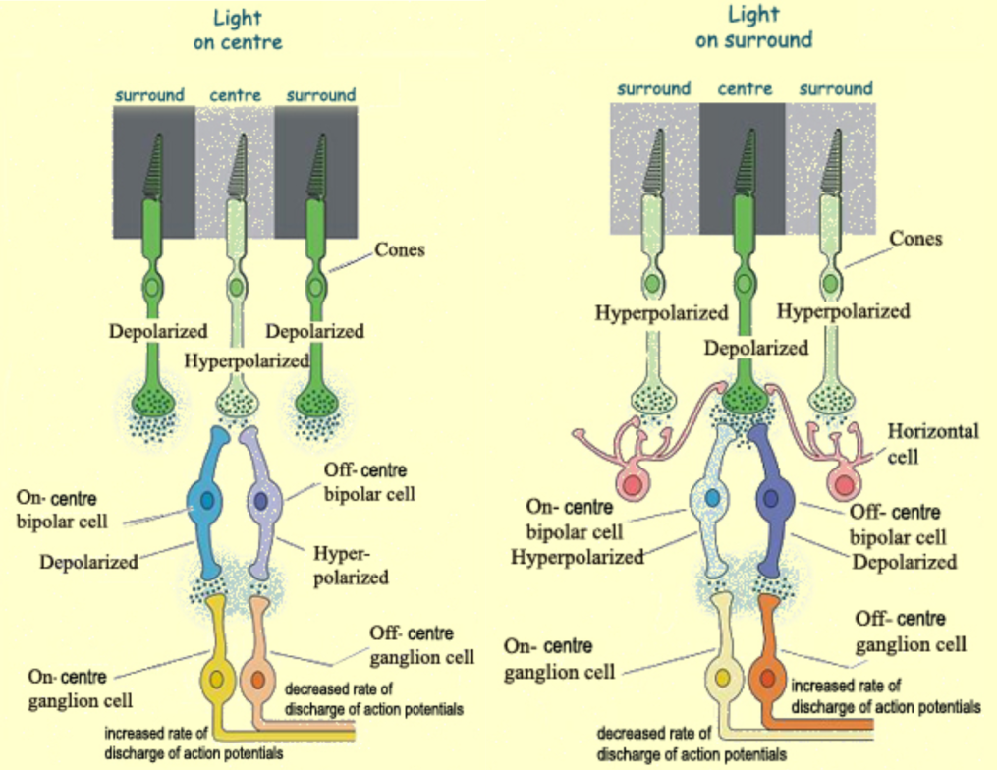
Compression Starts in Retina

Slide 13
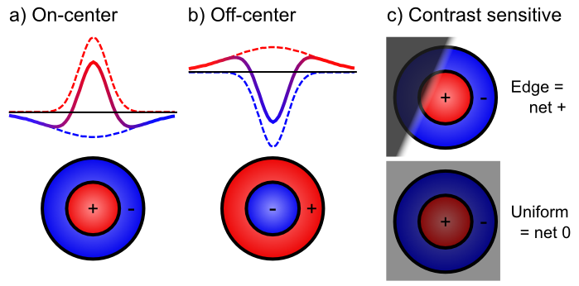
Retinal Contrast Filtering

Slide 14
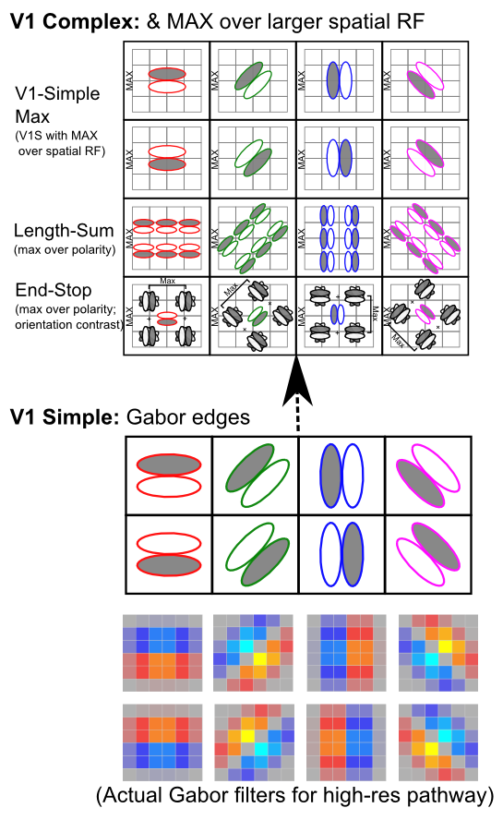
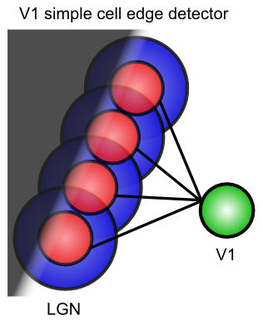
V1

Slide 15
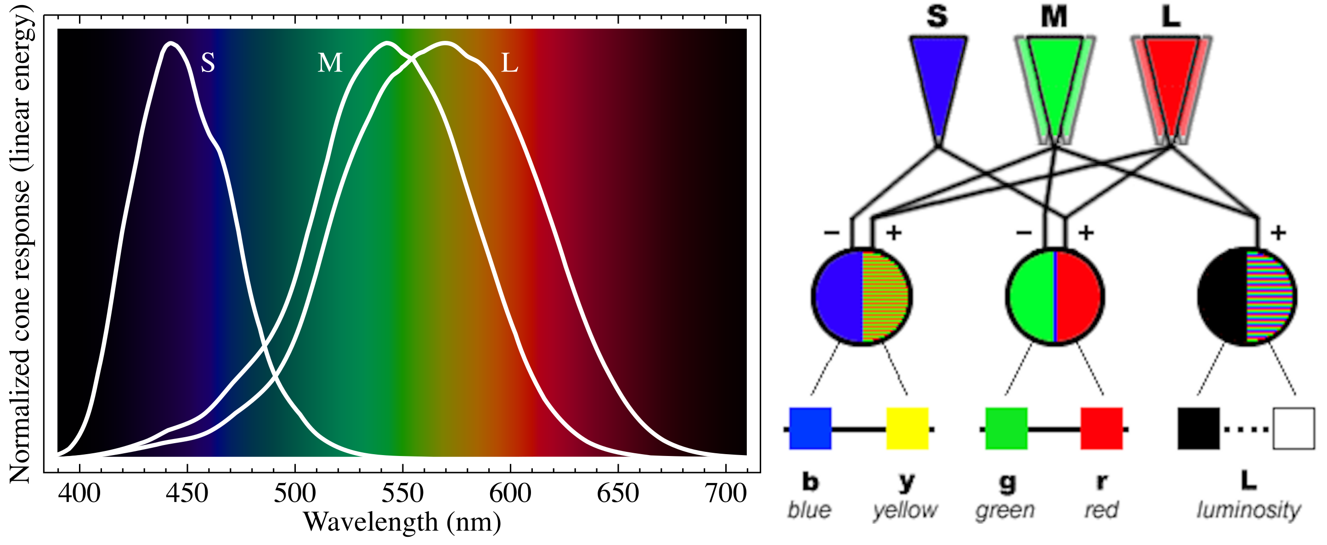
Trichromatic Color Vision
Color opponent process theory:
red vs. green,
blue vs. yellow
black vs. white (achromatic)

Slide 16
Color Contrast
https://www.youtube.com/watch?v=gur-_IGV7F8

Slide 17
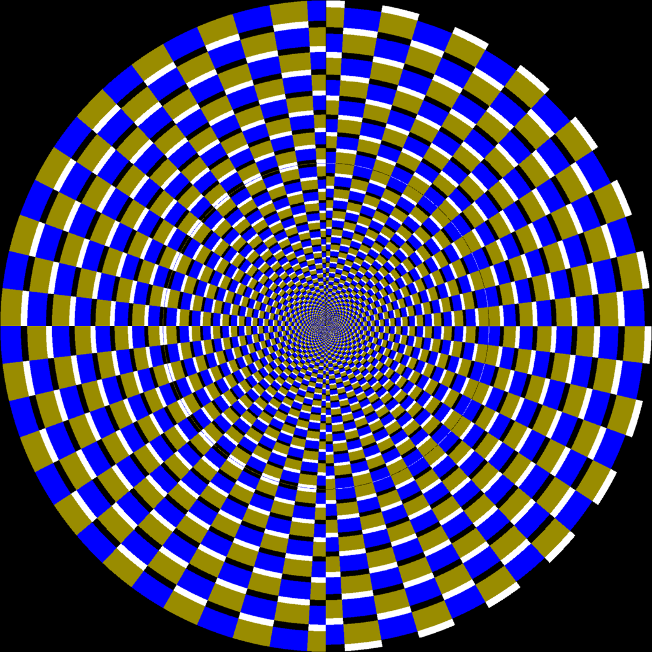

Slide 18
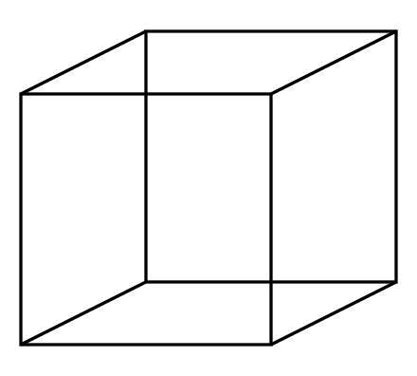
Time Contrast (we have a model of this)

Slide 19
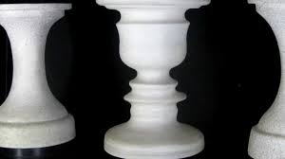
Time Contrast

Slide 20
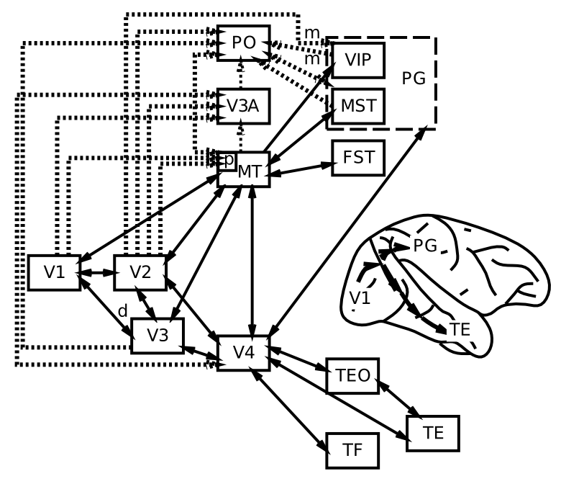
Visual Hierarchy: What vs Where

Slide 21
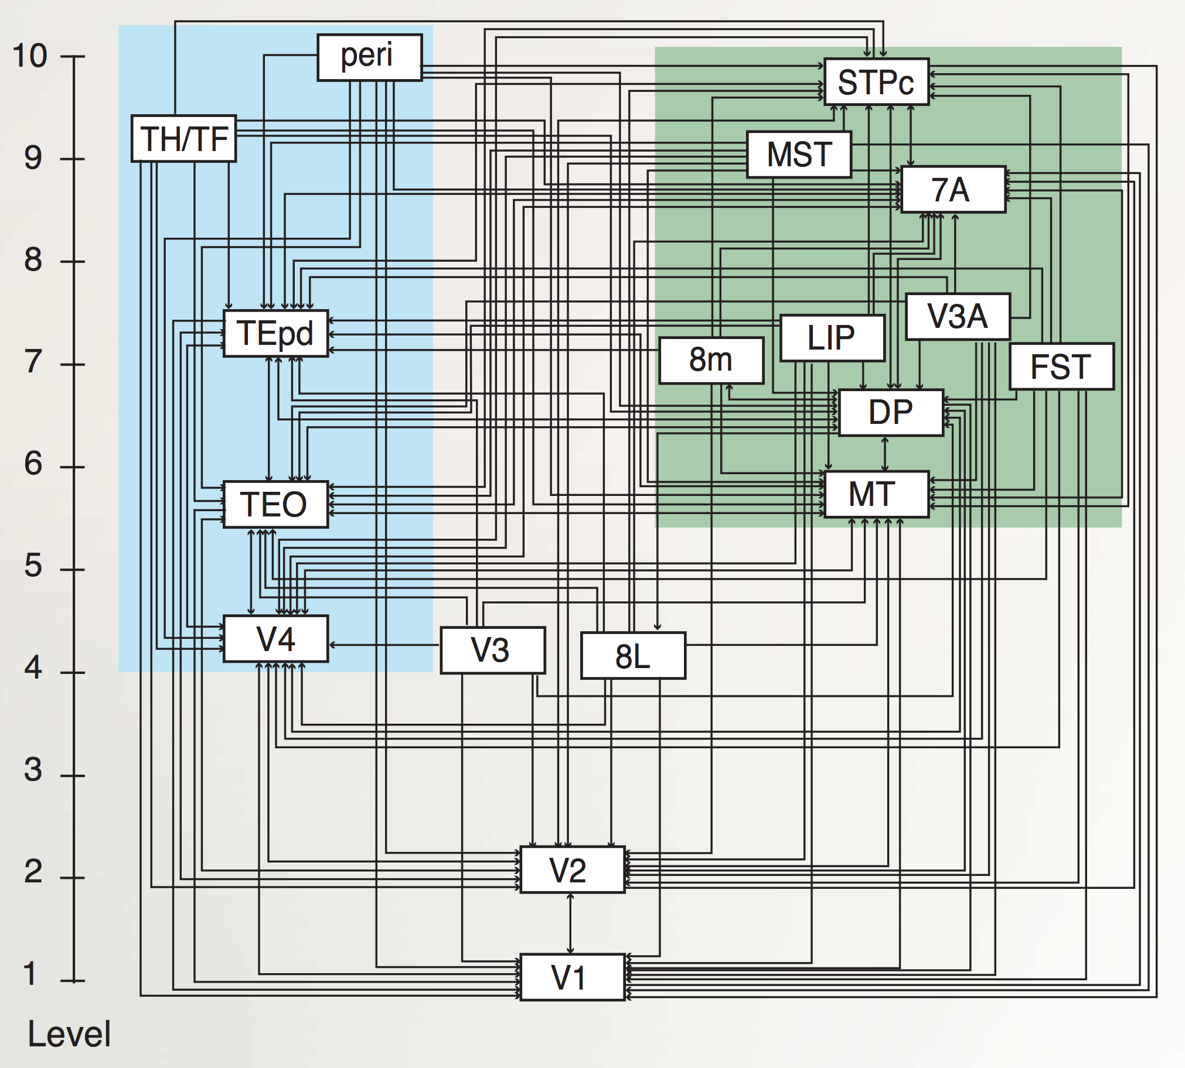
“Van Essen” Hierarchy
TE.. = Temporal
LIP, DP.. = Parietal
8L = Frontal Eye Field
To hippocampus:
TH/F = Parahippo
peri = Perirhinal
Markov et al., 2014

Slide 22
Hierarchy of Detectors (CCC = Compression: abstract, simplify)
Inferior Temporal (IT) cortex has high-level abstractions that are relevant to your life!
It takes a village of neurons to build up these abstractions.

Slide 23

Top-down Effects (recurrent, bidirectional connections)

Slide 24
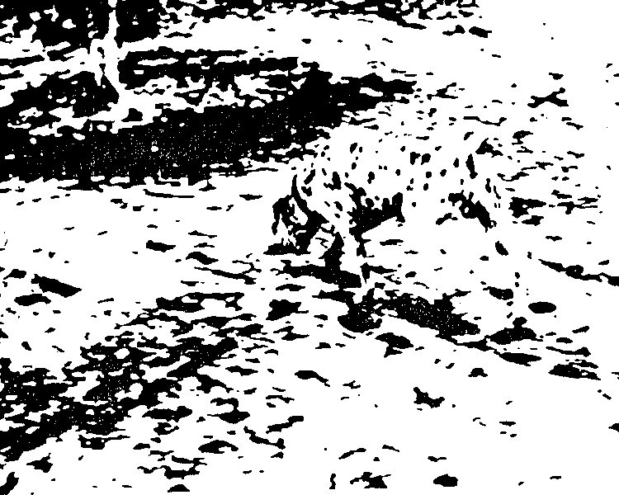
We see objects, not dots..
(much easier than disconnected pixels..)

Slide 25
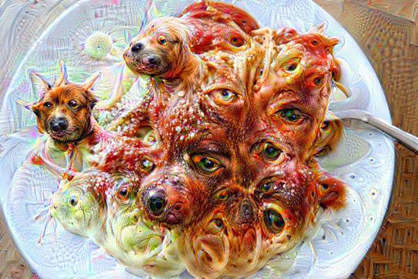
Sometimes, it goes too far…

Slide 26
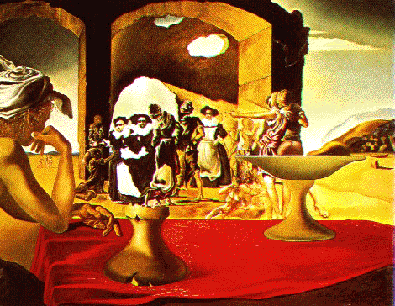
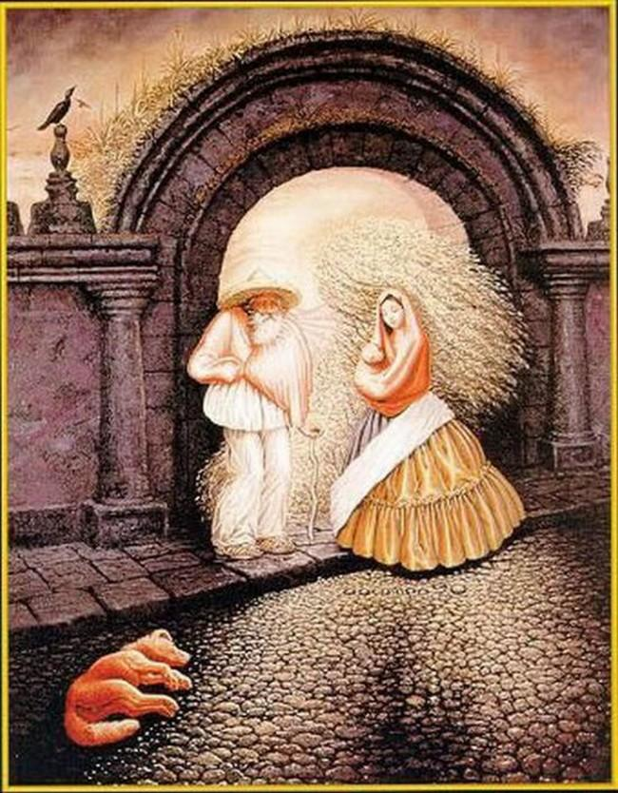
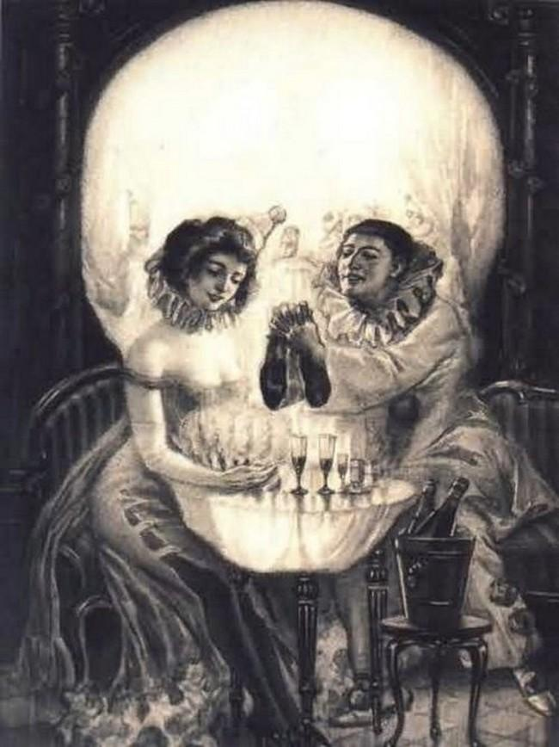
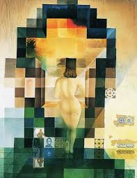
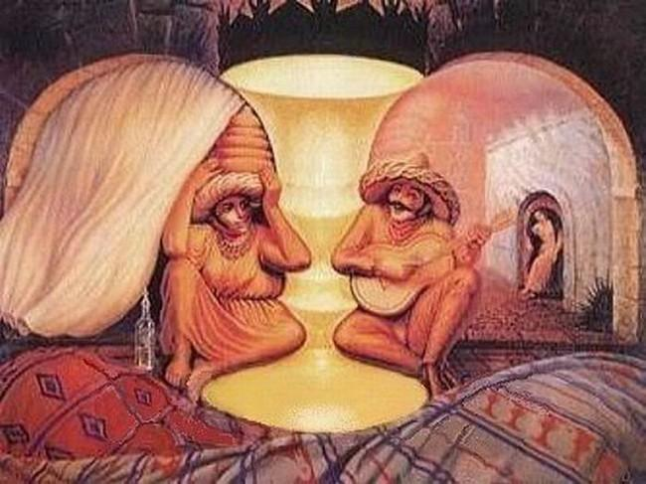
Dali!

Slide 27
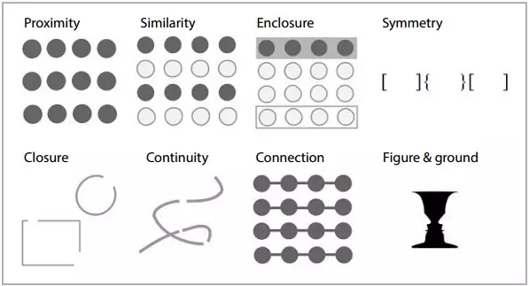
Gestalt Principles

Slide 28
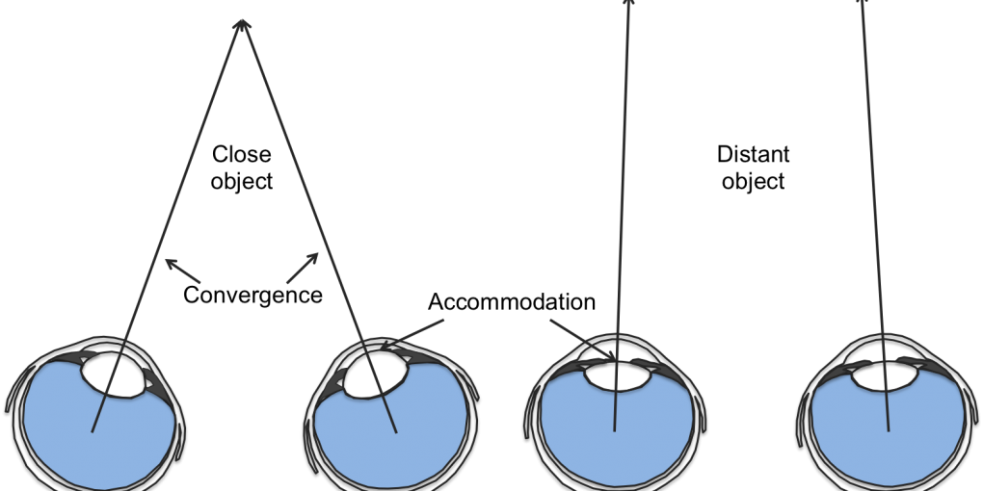
Binocular Disparity = 3D Depth

Slide 29
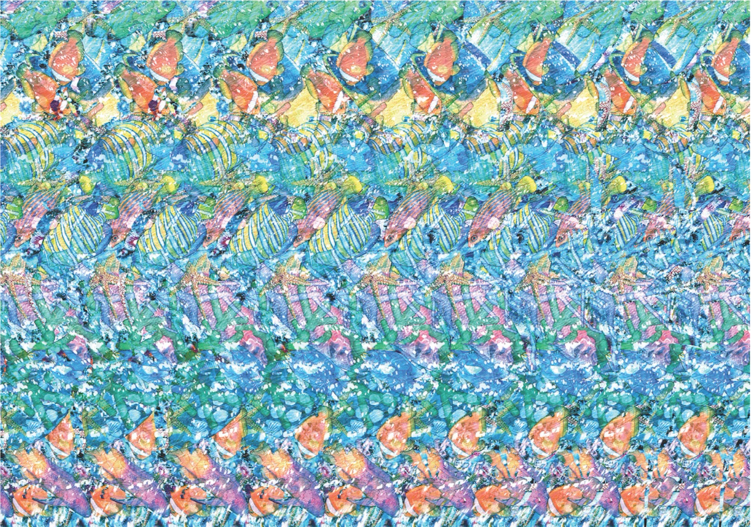
Binocular Disparity = 3D

Slide 30
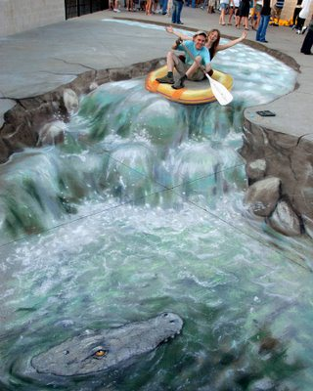
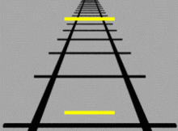
Monocular Depth Cues
Linear Perspective, relative size, interposition (blocking), horizon position

Slide 31
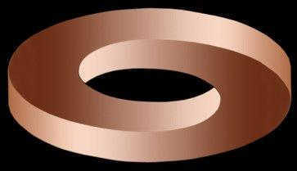
Shape from Shading

Slide 32
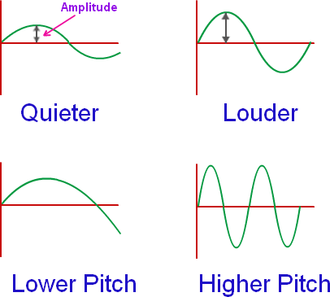
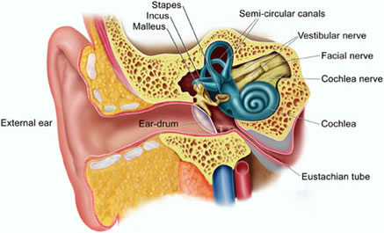
Audition
Basilar membrane: retina of the ear, located in cochlea
hair cells transduce sound, location along membrane = frequency
(place theory), except low-frequency = direct firing rate (frequency theory)
Interaural time / level differences = auditory localization

Slide 33
Olfaction, Taste, Touch
Olfactory receptors detect chemicals, including pheromones; olfactory bulb -> piriform cortex
Taste buds: sweet, salty, sour, bitter, umami?, fatty? -> insula cortex
Tactition: “touch” – mechanoreceptors, Thermoception: heat – thermoreceptors, Nociception: pain – A-delta (first), C-fibers (second) -> somatosensory cortex
CU: Chris Lowry: warmth -> serotonin happy cells

Slide 34
Nonstop Illusions!
https://www.youtube.com/watch?v=m86ae_e_ptU
Illusions reveal assumptions brain makes to compress sensory inputs into simplest interpretation of scene.

Slide 35

Spatial Attention and Neglect

Slide 36
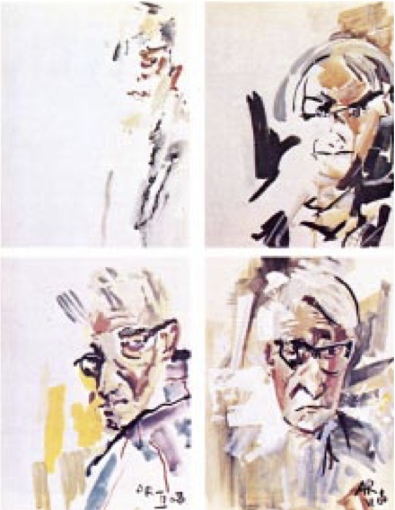
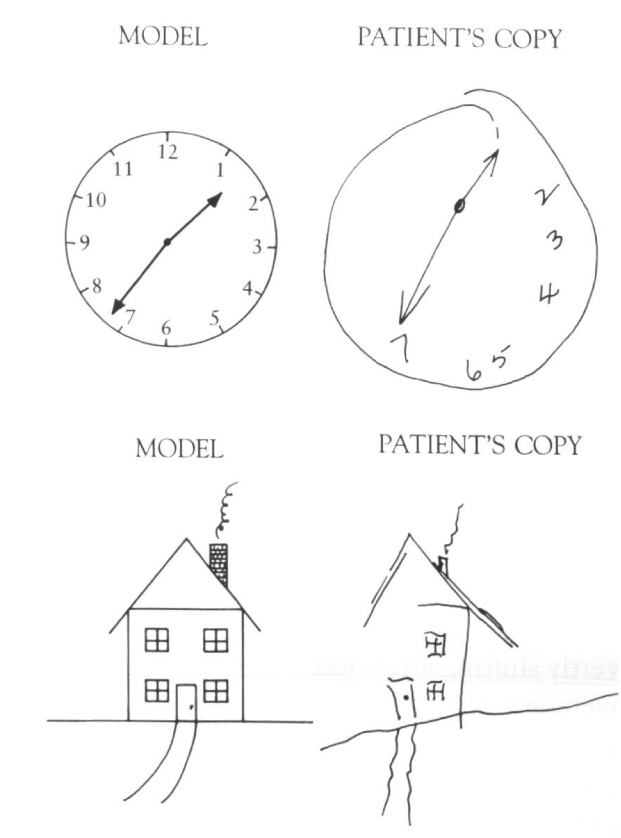
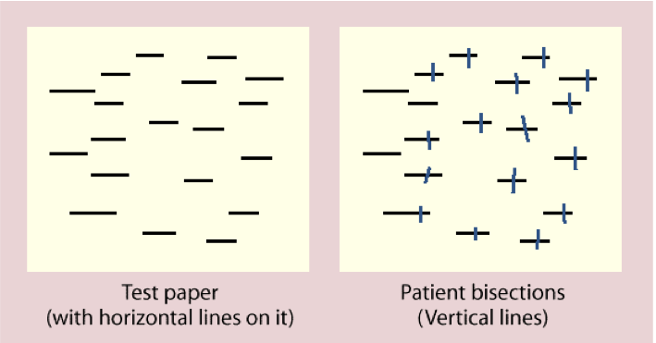
Hemispatial Neglect

Slide 37
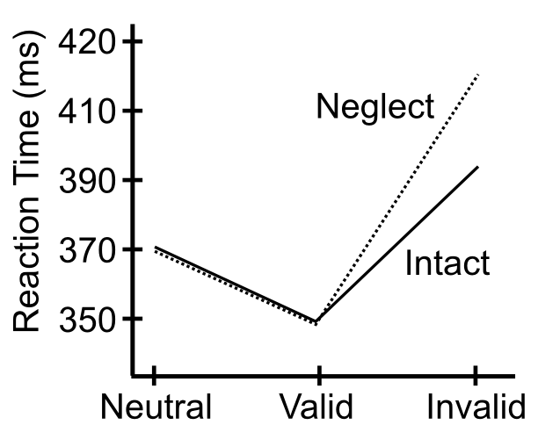
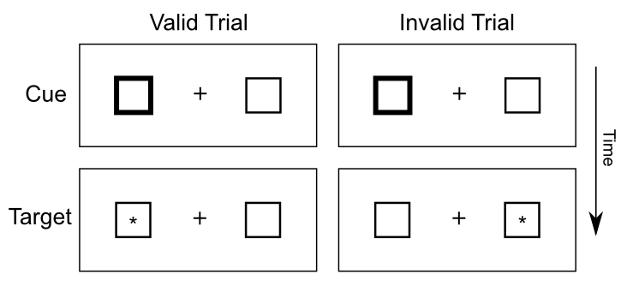
Posner Task

Slide 38
Psychophysics
Absolute threshold
Lowest level of stimulus intensity for 50% response
“How low can you go?”
Just-noticeable difference (JND)
Difference in stimulus intensity for 50% response
Weber’s law: JND proportional to stimulus intensity
Easier to tell small weight diff between two light objs, vs. two heavy
Contrast effect: relative to stimulus intensity, not an absolute difference!

Slide 39
Signal Detection Theory
Signal
Present
Absent
Yes
Hit
False Alarm
Response
Correct
Rejection
No
Miss

